Slide 1
Data Analysis of Sound Objects Used for Different Sound Purposes to Help Web designers to Enhance Web Functionality
Presented By
BIBEK LAMSAL

Slide 2
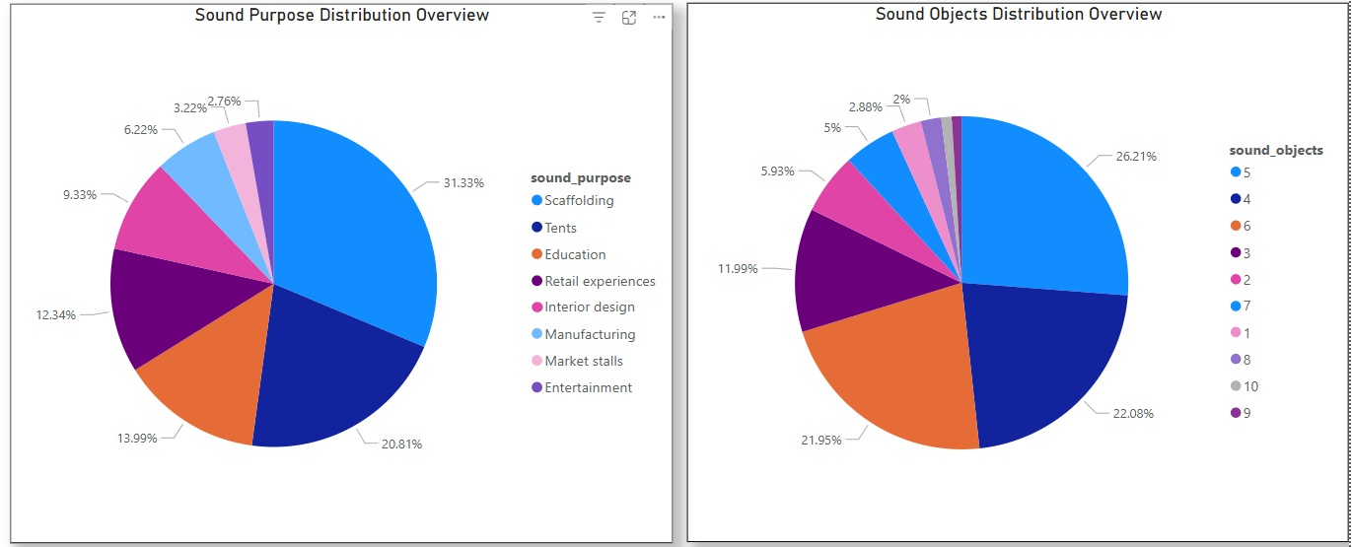
Visualization using dashboard

Slide 3
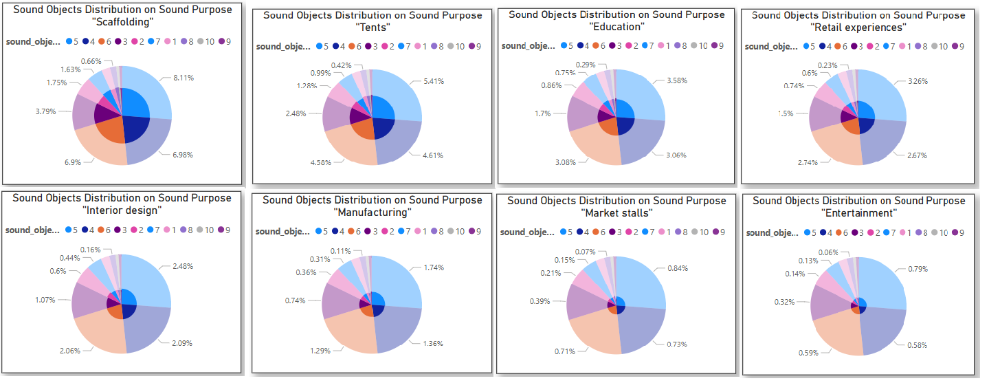

Slide 4
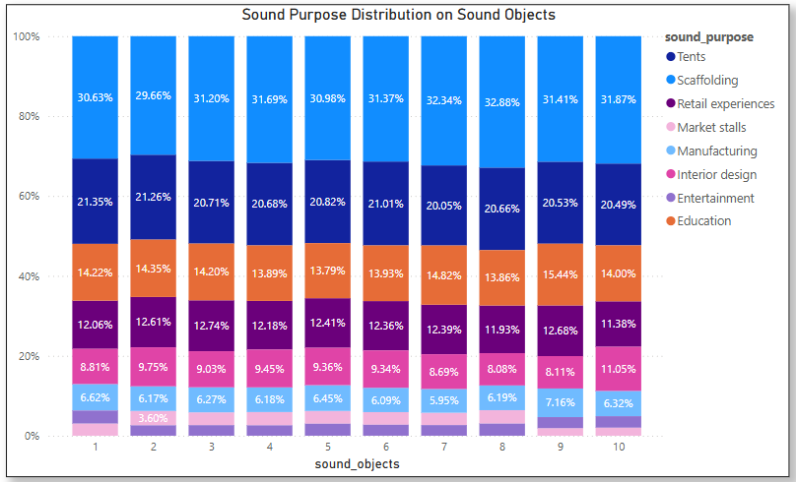
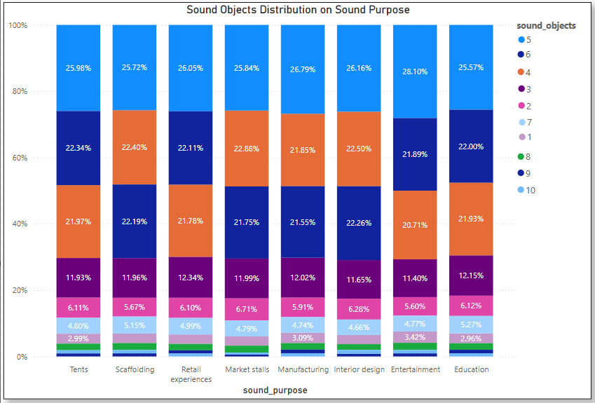

Slide 5
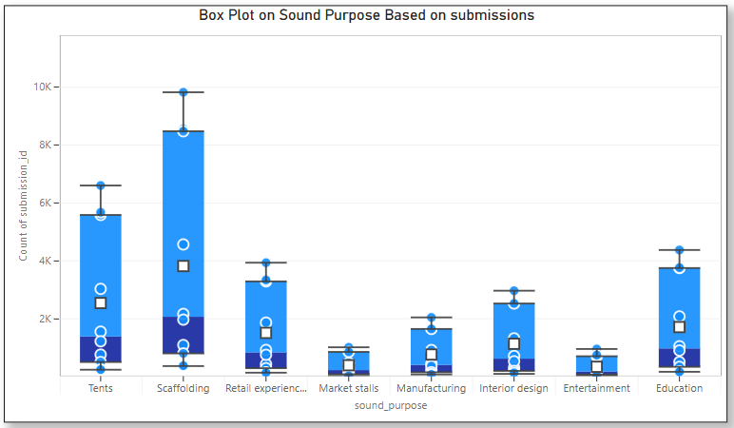

Slide 6
Insight:
Most Users Will Engage with Sounds Containing 4-6 Objects: The majority of sound recordings (around 66%) contain between 4 and 6 sound objects.
"Scaffolding" Indicates High User Activity: The significantly higher submission count and data variability for "Scaffolding" suggest strong user engagement or a large volume of user-generated content within this category.
"Scaffolding" and "Tents" are Dominant Content: "Scaffolding" (31.33% in the overall sound purpose distribution) and "Tents" (20.81%) are the most frequently represented sound purposes.
Consistency of Object Count Distribution (Stable Proportions): The relative proportions of different sound object counts within each sound purpose remain fairly consistent. For example, for "Scaffolding," around 26% have 5 objects, 18% have 6, and 17% have 4, and this pattern is broadly similar across other purposes, indicating a stable underlying structure.
Lower Engagement/Data Volume: "Entertainment" and "Market stalls" show consistently lower submission counts and less data variability compared to other categories that is just ~5%. This suggests potentially less user-generated content or a smaller overall dataset for these sound purposes.

Slide 7
RecommEndation
Prioritize Navigation and Visuals for "Scaffolding" and "Tents": Given their dominant representation in the data, ensure these two sound purposes have prominent placement .This could involve larger buttons, dedicated sections on the homepage, or distinct styling to guide users towards the most abundant content.
Optimize Default Views and Filters for 4-6 Sound Objects: the website's default display of sound listings and initial filtering options should cater to this range.
Strategic Placement of Less Popular Categories: Consider integrating "Entertainment" and "Market stalls" within broader thematic groupings or showcasing them as examples within relevant sections, rather than giving them the same level of prominence as the top categories in the main navigation.

Slide 8
Call To Action
Let’s set a meeting with the web designing team to brainstorm new approaches to add more sound features when user selects “Scaffolding” sound purpose.

